Slide 1
Splitting Text for Aspect wise Classification of Sentiment
Prepared By : Bipin Oli

Slide 2
Steps
Resolve Co-reference (He, she, it, etc ..)
Split sentences from text
Split based on (“but”, “because”, …)
Split based on conjunction (“,”, and”)

Slide 3
Example
Brian is an infamous senator but he has really good policies on immigration and education.
Brian is an infamous senator
Brian has really good policies on immigration .
Brian has really good policies on education .

Slide 4
Splitting based on conjunction

Slide 5
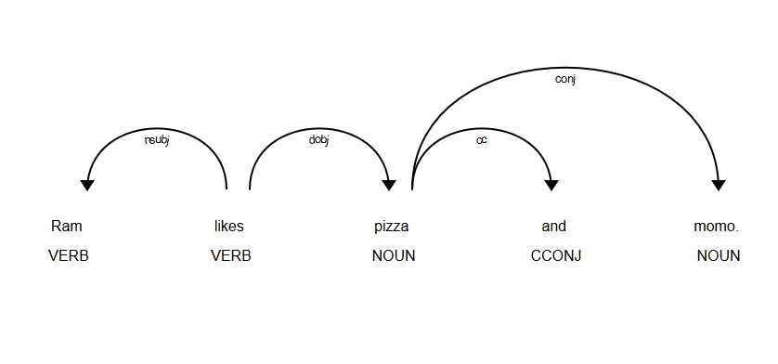
Spacy Dependency Tree

Slide 6
[“Ram”, “likes”, [“pizza”, “momo”], “.”]

Slide 7
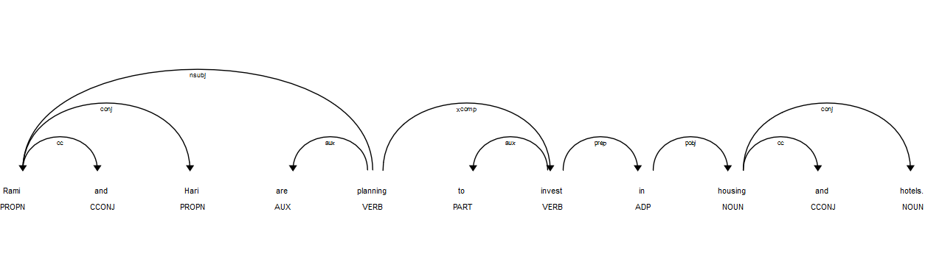
[ [“Rami”, ”Hari”], “are”, “planning”, “to”, “invest”, “in”, [“housing”, “hotels”], “.”]

Slide 8
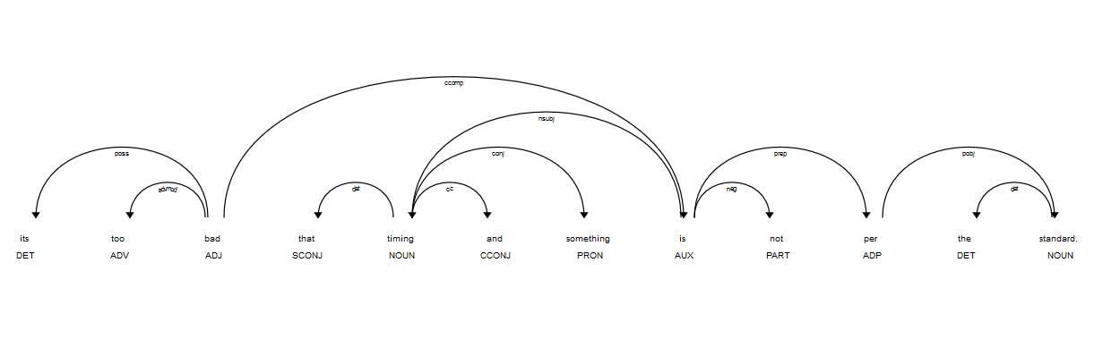
[ “its”, “too”, “bad”, “that”, [ “timing”, “something” ], “is”, “not”, “per”, “the”, “standard”, “.” ]

Slide 9
BFS
[“likes”]

Slide 10
[“likes”]

Slide 11
[“likes”, “Ram”, “pizza”]

Slide 12
[“likes”, “Ram”, “pizza”]

Slide 13
[“likes”, “Ram”, “pizza”]

Slide 14
[“likes”, “Ram”, “pizza”]

Slide 15
[“likes”, “Ram”, “pizza”]

Slide 16
[“likes”, “Ram”, “pizza”]

Slide 17
[“likes”, “Ram”, [“pizza”, “momo”]]

Slide 18
1
2
3
4
3
[“likes”, “Ram”, [“pizza”, “momo”]]

Slide 19
Sort
1
2
3
4
3
[ “Ram”, “likes”, [“pizza”, “momo”]]

Slide 20
Creating Sentences
[ “Ram”, “likes”, [“pizza”, “momo”]]
[ “Ram”, [ “likes pizza” , “likes momo” ] ]
[ “Ram likes pizza” , “Ram likes momo” ]

Slide 21
Thank You!

